Slide 1
BI-DIRECTIONAL SEARCH ALGORITHM
Uninformed Search Algorithms

Slide 2
Uninformed Search Algorithm
Are a class of search algorithms used in Artificial Intelligence and Computer Science to explore a search space without any prior knowledge or information about the problem other than the problem's definition.
These algorithms are "uninformed" because they don't use heuristics or domain-specific knowledge to guide their search; instead, they rely on basic exploration strategies.

Slide 3
Bi-Directional Search Algorithm
Is a form of Uninformed Search Algorithm where we find the shortest path between the Starting Node from and to the End Node.
We do this by creating two Breadth-First Search Algorithms: one starting from the Start Point to the End Point, and another starting from the End Point to the Start Point.
A functionality of this search algorithm is to identify the shortest possible path from Start Point to End Point by performing two Breadth-First Searches simultaneously.

Slide 4
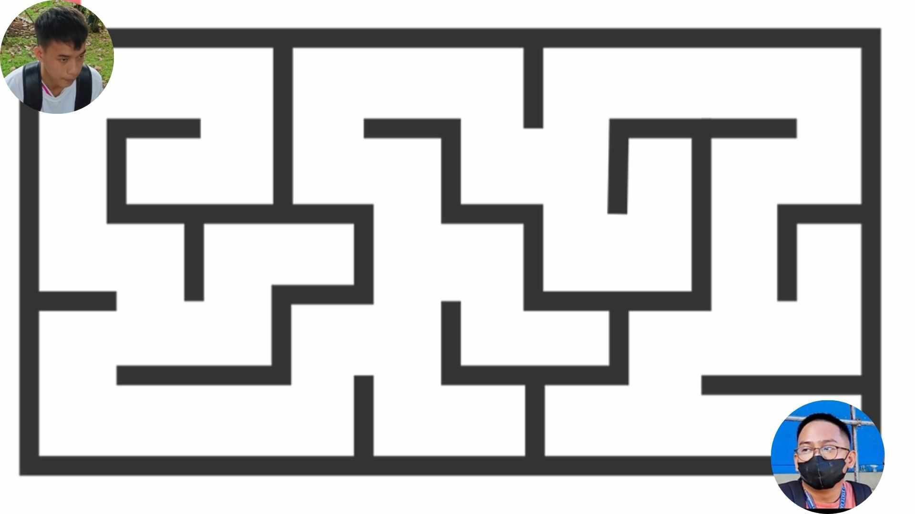
I: Come up with a simple problem from your (daily or weekly) routine or your favorite game features that you want to improve.
Problem: KJ wants to go to Allan at Parola but is not familiar with the path from Tagbak to Parola. Allan on the other hand does not know the path from Parola to Tagbak either. They need to meet as soon as possible because they have an appointment at Parola and they can’t be late.

Slide 5
I: From this problem, justify why it is considered a problem.
Response: This is considered a problem because there are multiple ways for KJ to reach Parola and so does Allan to Tagbak. They are running out of time and they have to work together to simultaneously explore the possible paths from their end and when they meet, they will discuss how to get from Tagbak (KJ) to Parola (Allan).

Slide 6
I: Use the uninformed search to solve your problem & choose what search category you’ll use (Space search or Search Tree).
Solution: We will be using a Search Tree.

Slide 7
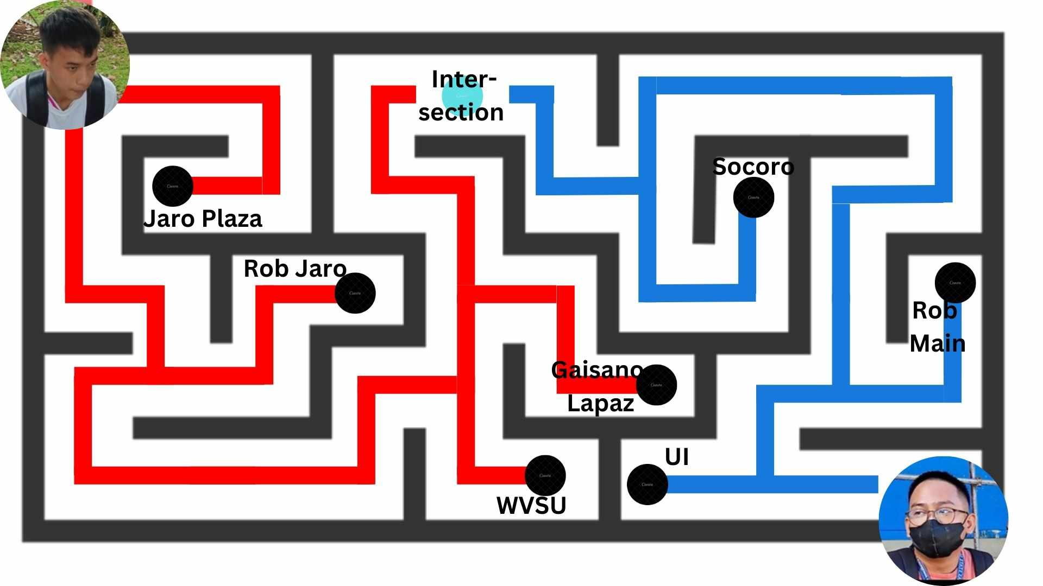
Step 1:

Slide 8
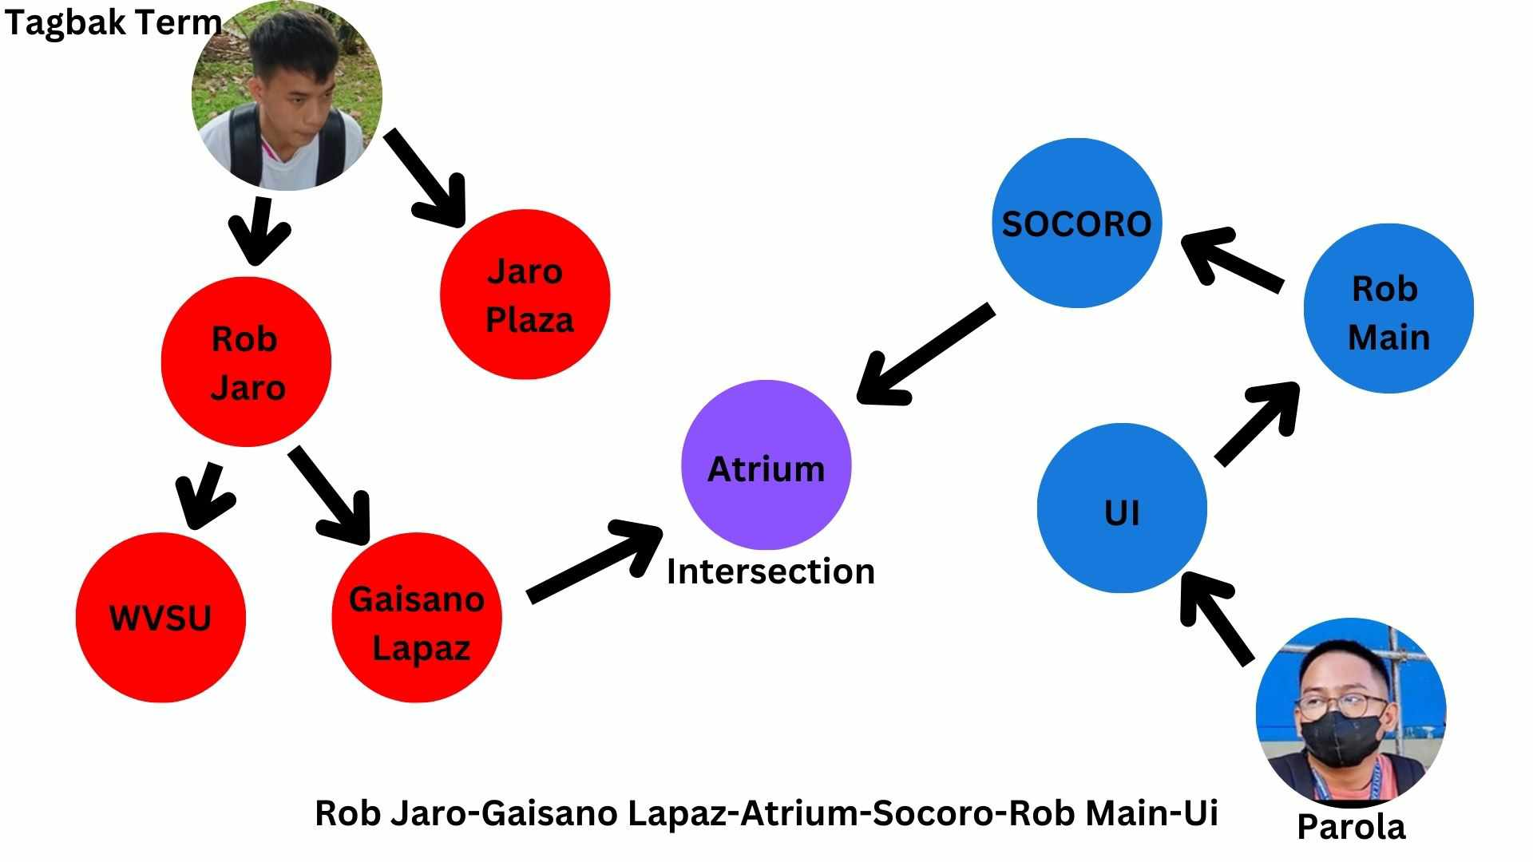
Step 2:

Slide 9

Step 3:

Slide 10
Bi-Directional Search Algorithm
Pros
Cons
Efficiency: Reduces search time and computational resources by simultaneously exploring from both start and end points.
Optimality: Guarantees finding the shortest path when a meeting point is reached.
Memory-Saving: Often requires less memory due to smaller search spaces, beneficial in memory-constrained scenarios.
Complexity: Implementation can be more complex compared to unidirectional search.
Not Always Efficient: In poorly connected graphs or if the two searches don’t meet, efficiency gains may not be realized.
Limited Applicability: Not ideal for all scenarios; simpler methods may suffice in some cases.

